Slide 1
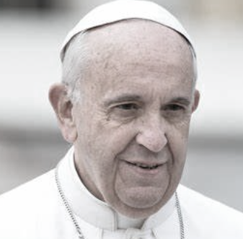
Pope Francis’s Ash Wednesday Homily, 14th February 2024
Lent, immerses us in a bath of purification. It helps us to remove all the cosmetics that we use in order to appear presentable.
Life is not a play; Lent invites us to come down from the stage and return to the heart, to the reality of who we are: a return to the heart and the truth.
Let us acknowledge our real identity, removing the masks we so often wear. Let us not be afraid to strip ourselves of worldly trappings and return to the heart, returning to what is essential.

Slide 2
The uniqueness of Catholic education and the role of our schools in the Church

Slide 3
To what extent are the following statements accurate?
Catholic schools are allowed to be more selective about the students they admit.
The mandatory curriculum for non-faith schools is not mandated in Catholic schools.
To teach in a Catholic school, it is essential to be a practising Catholic.
Catholic schools’ funding comes from the Church, rather than central government.
Catholic schools can not give preference to Catholic children, over non-Catholic children.
In choosing Catholic education, parents accept that children will follow the RE curriculum, which is mandatory in all Catholic schools.
Catholic schools were first formed to break away from mainstream schools, to provide a distinctly Catholic education.
Catholic schools are exempt from inspection; they have their own inspection system.
The church borrows/leases land from the state to build Catholic schools.
School Governing Bodies comprise of only practising Catholics, including clergy.

Slide 5
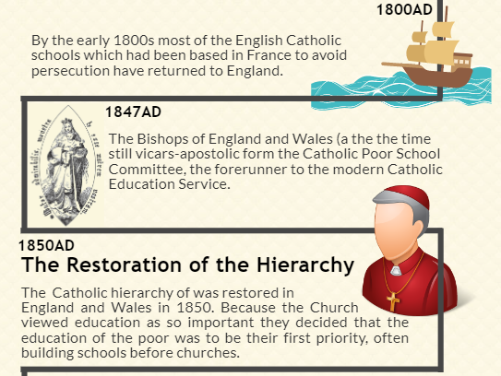

Slide 6
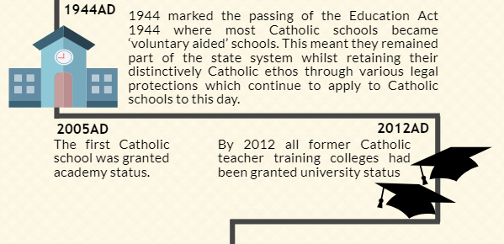

Slide 7
Some facts about Catholic education…
10% of the national total of maintained schools.
2200 Catholic schools and colleges in England and Wales
We educate over 850,000 pupils.
The Catholic Church and the Church of England together provide one-third of all of the schools in the country
And account for 98% of all schools with a religious character.
The church provides the land for Catholic schools to exist.
Schools work within several chains of authority and partnership:
Diocese CETs DofE Secretary of State
CES CSI Ofsted Local Authorities

Slide 8
‘In a Catholic school, the true development of the person, pupils and staff, takes precedence over all other things’.
Archbishop Vincent Nichols
‘Leading a Catholic School’ March 2009
'Education is not a profession but an attitude, a way of being; in order to educate it is necessary to step out of ourselves and be among young people to accompany them in their stages of growth. Give them hope and optimism for their journey in the world. Teach them to see the beauty and goodness of creation. The sole objective of the educating community is to develop mature young people who are simple, competent and honest, who know how to live with fidelity, who can live life as a response to God’s call, and their future profession as a service to society.’
Pope Francis
"I’m a great supporter of Catholic Education – because I’m old enough to remember what our bishops from around the world agreed in 1965 what we were about in our Catholic Schools. They said we were to serve children who ‘were poor, those who did not have the faith and those who did not have the support of their families’! In other words, our Catholic Education System is on the side of those who really struggle. That’s a tough ask in our world, where there’s so much emphasis on 'league tables’ ‘success’ and ‘targets’. Thank you for looking to join our local Catholic community in exploring how we in our local school and worshipping community can work together to provide an enriching environment for all our children."
Fr Jim O'Keefe

Slide 9
Bishops’ Conference (1965) Catholic schools are committed to:
The Search for Excellence
The Education of the Whole Person
The Uniqueness of the Individual
Education for All
Moral Principles

Slide 10
Gospel, Luke 6:36-38
Be compassionate just as your Father is compassionate.
Do not judge, and you will not be judged; do not condemn, and you will not be condemned; forgive, and you will be forgiven.
Give, and there will be gifts for you: a full measure, pressed down, shaken together, and overflowing, will be poured into your lap.
Notes:
Lord, do not deal with us according to our sins.

Slide 11
Luke 10:25-37
On one occasion an expert in the law stood up to test Jesus. “Teacher,” he asked, “what must I do to inherit eternal life?”
“What is written in the Law?” he replied. “How do you read it?”
He answered, “‘Love the Lord your God with all your heart and with all your soul and with all your strength and with all your mind’^{[a]}; and, ‘Love your neighbour as yourself.’^{[b]}”
“You have answered correctly,” Jesus replied. “Do this and you will live.”
But he wanted to justify himself, so he asked Jesus, “And who is my neighbour?”
In reply Jesus said: “A man was going down from Jerusalem to Jericho, when he was attacked by robbers. They stripped him of his clothes, beat him and went away, leaving him half dead. ³¹ A priest happened to be going down the same road, and when he saw the man, he passed by on the other side. ³² So too, a Levite, when he came to the place and saw him, passed by on the other side. ³³ But a Samaritan, as he travelled, came where the man was; and when he saw him, he took pity on him. ³⁴ He went to him and bandaged his wounds, pouring on oil and wine. Then he put the man on his own donkey, brought him to an inn and took care of him. ³⁵ The next day he took out two denarii^{[c]} and gave them to the innkeeper. ‘Look after him,’ he said, ‘and when I return, I will reimburse you for any extra expense you may have.’
“Which of these three do you think was a neighbour to the man who fell into the hands of robbers?”
The expert in the law replied, “The one who had mercy on him.”
Jesus told him, “Go and do likewise.”
Notes:
A Summary and Analysis of the Parable of the Good Samaritan – Interesting Literature

Slide 12
Matthew 5
Seeing the crowds, he went up on the mountain, and when he sat down, his disciples came to him.
And he opened his mouth and taught them, saying:
“Blessed are the poor in spirit, for theirs is the kingdom of heaven.
“Blessed are those who mourn, for they shall be comforted.
“Blessed are the meek, for they shall inherit the earth.
“Blessed are those who hunger and thirst for righteousness, for they shall be satisfied.
“Blessed are the merciful, for they shall receive mercy.
“Blessed are the peacemakers, for they shall be called sons of God.
“Blessed are you when others revile you and persecute you and utter all kinds of evil against you falsely on my account. Rejoice and be glad, for your reward is great in heaven.
“You are the salt of the earth, but if salt has lost its taste, how shall its saltiness be restored? It is no longer good for anything except to be thrown out and trampled under people's feet.
“You are the light of the world. A city set on a hill cannot be hidden. Nor do people light a lamp and put it under a basket, but on a stand, and it gives light to all in the house. In the same way, let your light shine before others, so that they may see your good works and give glory to your Father who is in heaven.”

Slide 13
Luke 15:11-32
¹¹ And he said, “There was a man who had two sons. ¹² And the younger of them said to his father, ‘Father, give me the share of property that is coming to me.’ And he divided his property between them. ¹³ Not many days later, the younger son gathered all he had and took a journey into a far country, and there he squandered his property in reckless living. ¹⁴ And when he had spent everything, a severe famine arose in that country, and he began to be in need. ¹⁵ So he went and hired himself out to one of the citizens of that country, who sent him into his fields to feed pigs. ¹⁶ And he was longing to be fed with the pods that the pigs ate, and no one gave him anything.
¹⁷ “But when he came to himself, he said, ‘How many of my father's hired servants have more than enough bread, but I perish here with hunger! ¹⁸ I will arise and go to my father, and I will say to him, “Father, I have sinned against heaven and before you. ¹⁹ I am no longer worthy to be called your son. Treat me as one of your hired servants.”’ ²⁰ And he arose and came to his father. But while he was still a long way off, his father saw him and felt compassion, and ran and embraced him and kissed him. ²¹ And the son said to him, ‘Father, I have sinned against heaven and before you. I am no longer worthy to be called your son.’ ²² But the father said to his servants, ‘Bring quickly the best robe, and put it on him, and put a ring on his hand, and shoes on his feet. ²³ And bring the fattened calf and kill it, and let us eat and celebrate. ²⁴ For this my son was dead, and is alive again; he was lost, and is found.’ And they began to celebrate.
²⁵ “Now his older son was in the field, and as he came and drew near to the house, he heard music and dancing. ²⁶ And he called one of the servants and asked what these things meant. ²⁷ And he said to him, ‘Your brother has come, and your father has killed the fattened calf, because he has received him back safe and sound.’ ²⁸ But he was angry and refused to go in. His father came out and entreated him, ²⁹ but he answered his father, ‘Look, these many years I have served you, and I never disobeyed your command, yet you never gave me a young goat, that I might celebrate with my friends. ³⁰ But when this son of yours came, who has devoured your property with prostitutes, you killed the fattened calf for him!’ ³¹ And he said to him, ‘Son, you are always with me, and all that is mine is yours. ³² It was fitting to celebrate and be glad, for this your brother was dead, and is alive; he was lost, and is found.’”

Slide 14
The uniqueness of Catholic education and the role of our schools in the Church is complex and difficult to measure
Palpable, plain and visible | Unquantifiable, mysterious
Liturgy, prayer and mass Ethos, culture and expectations Preparing for the sacraments Direct relationships with parish Visual symbols and signposting Physical environment Chaplaincy Mission statement and aims RE and Christ’s teaching Adherence to Church law Extra-curricular opportunities Leadership structures | That something different The feel of a school that you can’t quite put your finger on It’s like something else is at play Children are being fed in a way that other schools can’t Expectation, self-belief, high standards, discipline

